Slide 1
“AUTOMATED PLANT/CROP WATERING USING SENSORS AND WEATHER FORECAST DATA ”

Slide 2






The Problem
The conventional irrigation system is manually operated and
it is based on real-time weather and soil conditions observed manually.
1

Slide 3
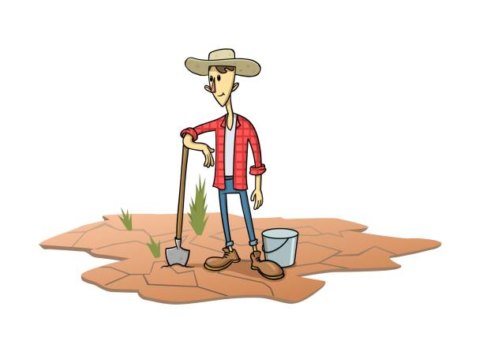
Water Scarcity
2
Today the greatest problems faced by the world is water scarcity and agriculture being a demanding occupation consumes plenty of water.

Slide 4


Aim
The motive of our model is to provide a system which saves money, time and effort of the farmers & gardeners.
In normal irrigation it requires manpower as a thorough supervision is required for the crop.

Slide 5
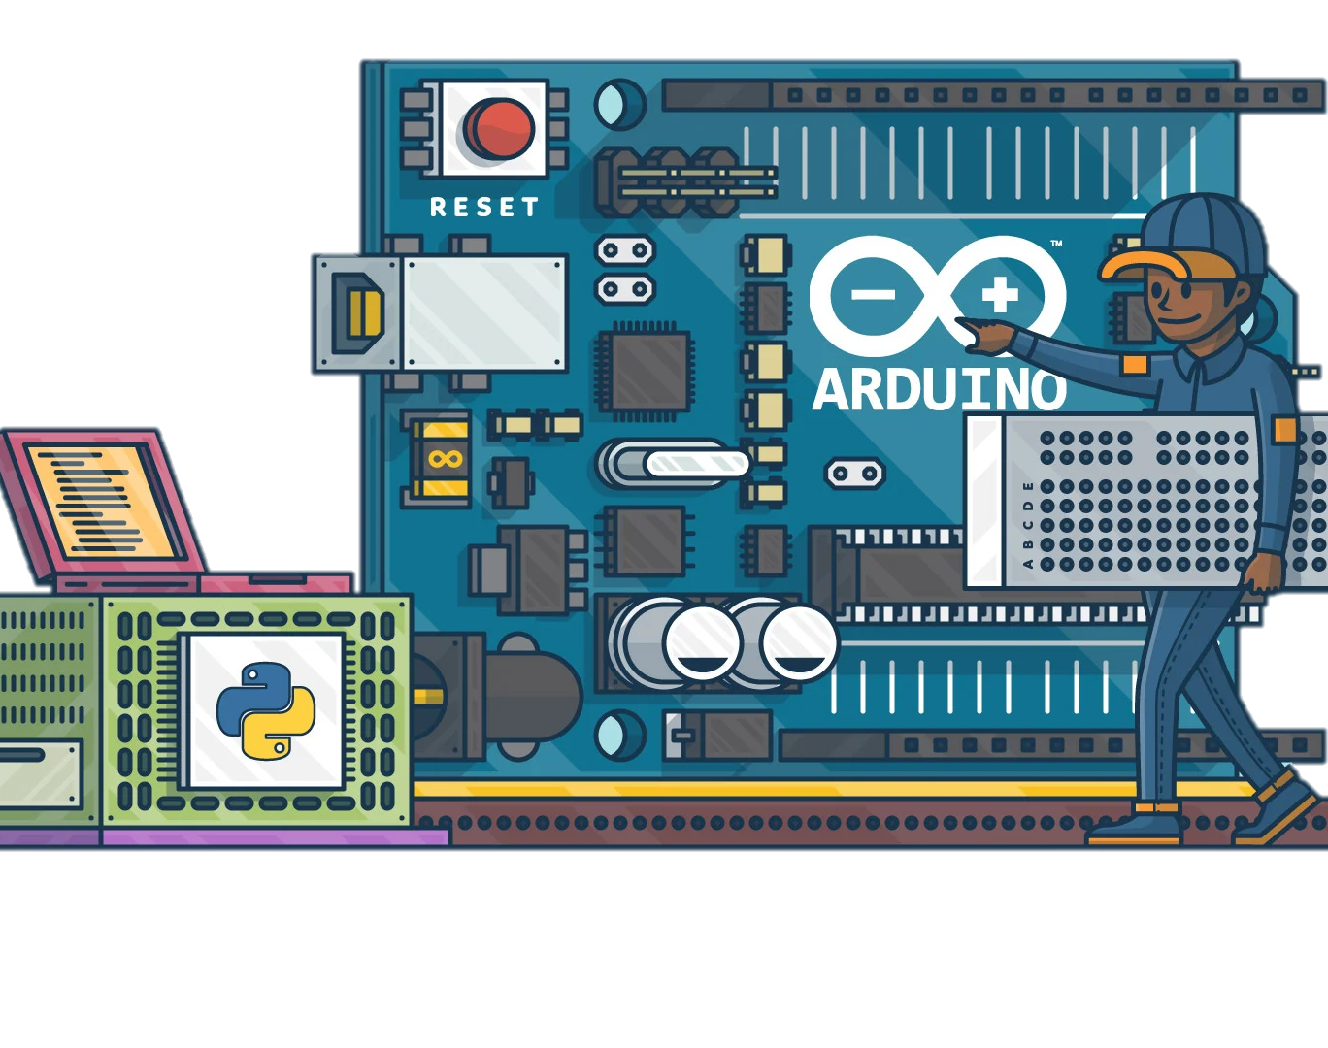
Our Solution
A smart irrigation system based on various sensor and operated by the moisture content data of the soil and the rain prediction from weather API using different microcontrollers.

Slide 6


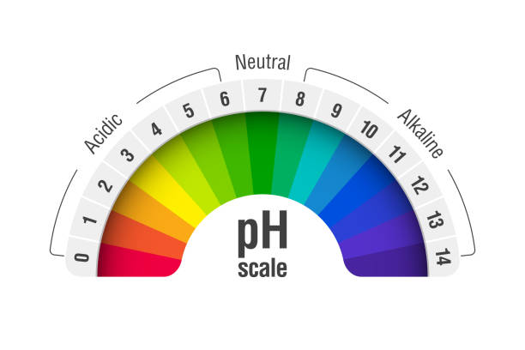
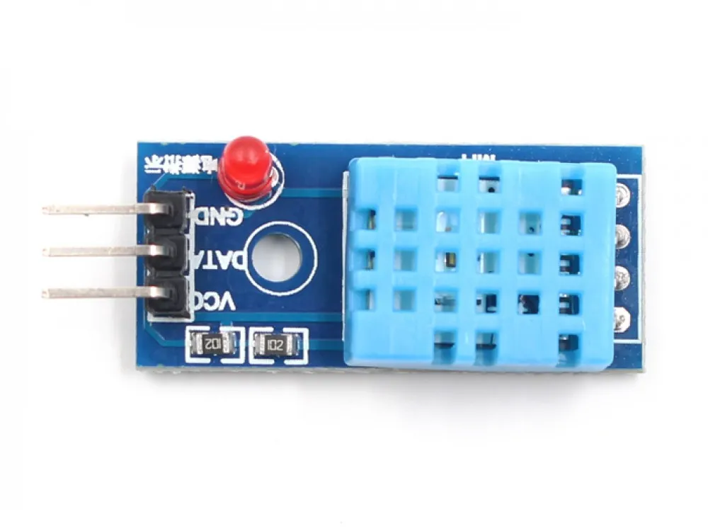

Selection of some Components depends on…
Internet
Availability
Area of
Land
Additional
Features

Slide 7
Major components required by our model which will be relevant for most of the conditions
Components | Specs | Qty
Microcontroller | ESP-32 | 1
Moisture sensor | capacitive | N
Relay | - | -
Water Motor/pump | - | -
GSM GPRS Module | - | -
Temperature, Humidity sensor | DHT22 | 1

Slide 8


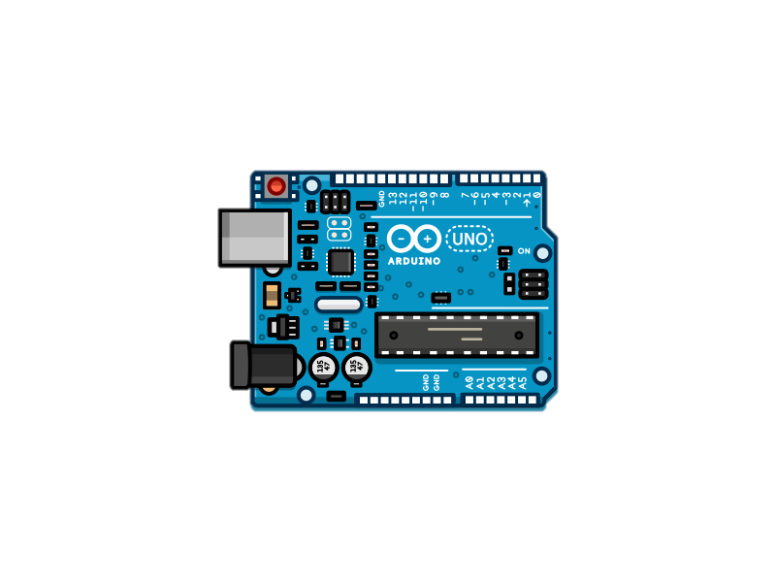

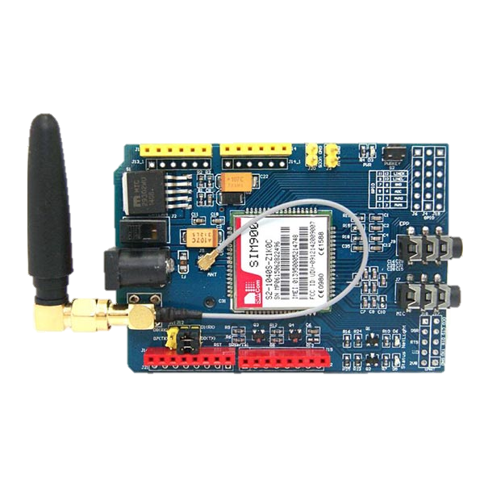


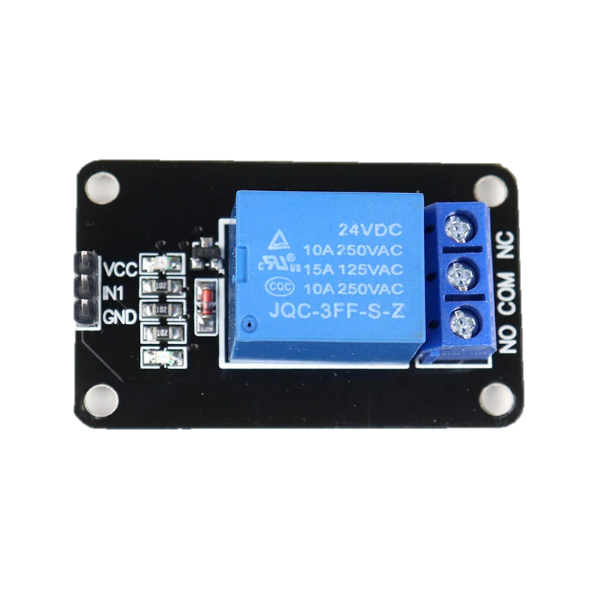
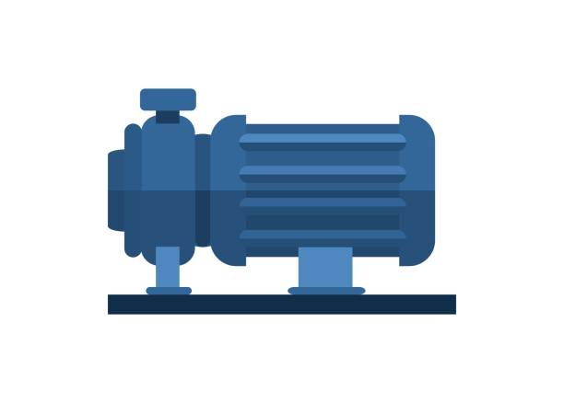
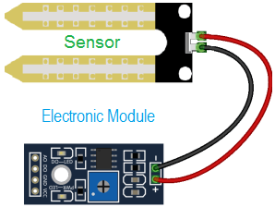
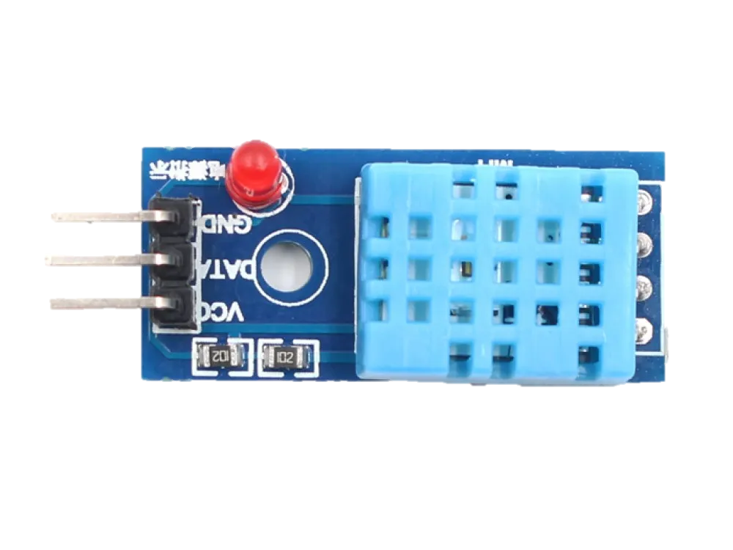
Data upload to
cloud
Data sync to
connected
devices
API
Weather data collection
I/P
Data from sensors
I/P
Signal to
relay
O/P
ON/OFF

Slide 9
Start
Get values from sensor
Moisture<x
NO
YES
Flow-Chart
YES
T sensor>y degrees
NO
YES
Rain
Sprinkle water
NO
Sprinkle water
End

Slide 10
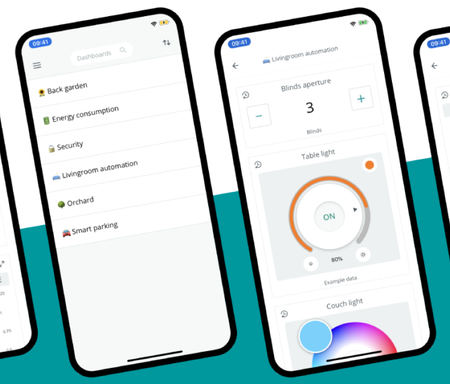
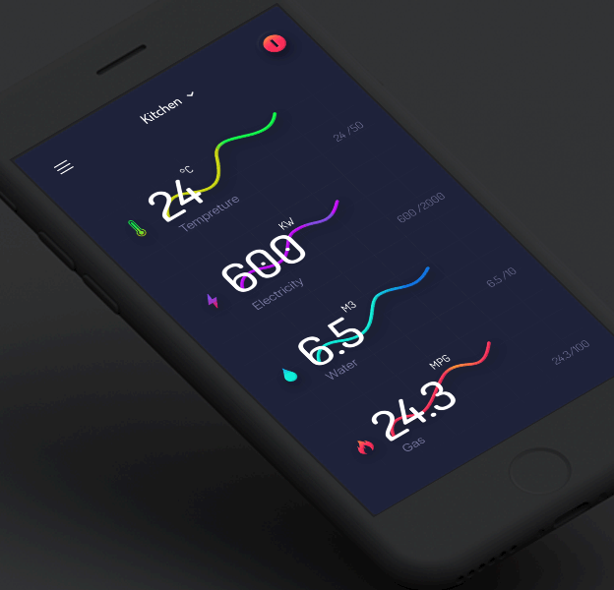
Arduino IoT interface
The data analysis page can be accessed through our cloud webpage.

Slide 11
Expenses for a small home garden
Arduino UNO-700/-
6XMoisture sensor(Capacitive)-780/-
Relay(1 Channel,5v)-50/-
Water Motor/pump-200/-
GSM GPRS Module-850/-
Temperature Sensor-200/-
Total Major expenses-2780/-
(Assuming manual sprinklers or drip irrigation system is implemented)
2800<Automation Cost<4000

Slide 12
Government Schemes
Pradhan Mantri Krishi Sinchayee Yojana (PMKSY) has been launched with the
motto of providing “Har Khet Ko Paani” and end-to-end solutions in irrigation
supply chain, viz. water sources, distribution network and farm level
applications.

Slide 13

Thank you

